Slide 1
Dewatering Solutions using MODFLOW
Jeremy Fowler, Braden Error, Hani Abu-Hmeidan
Group 1

Slide 2
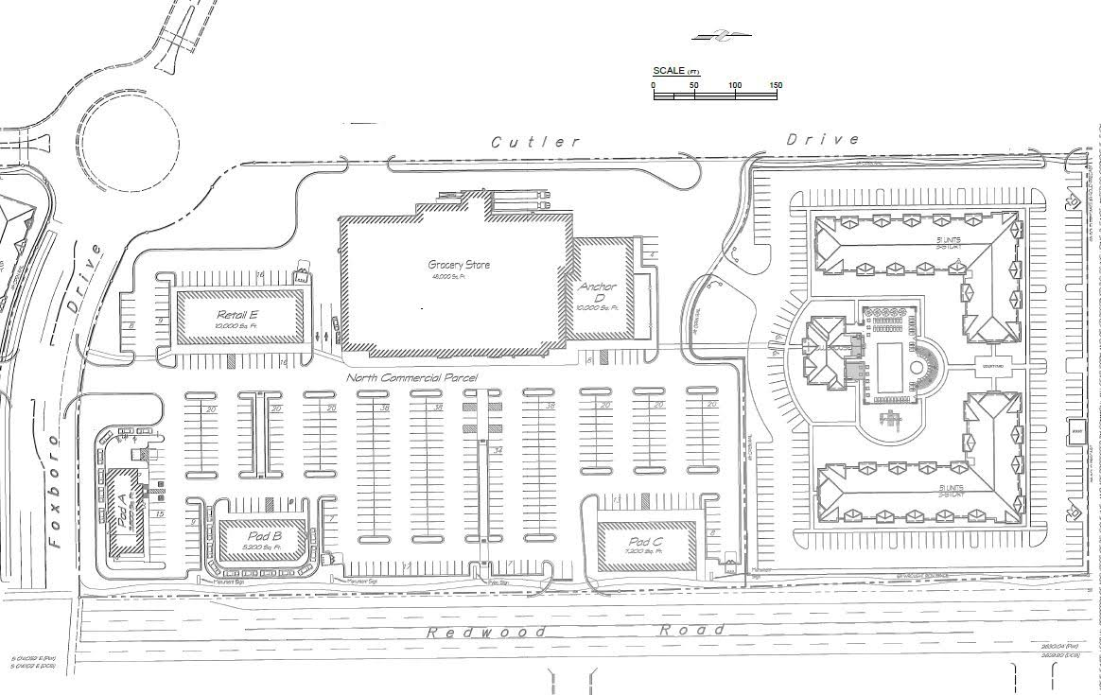
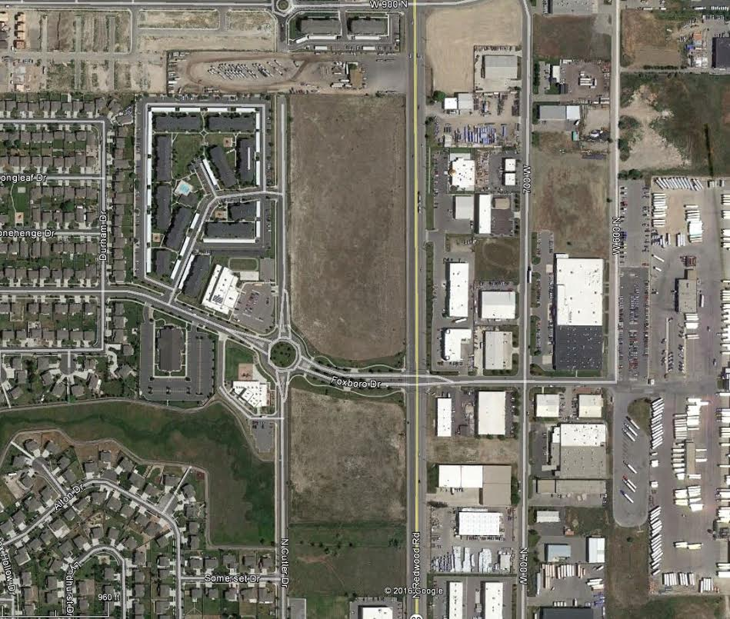
Location

Slide 3
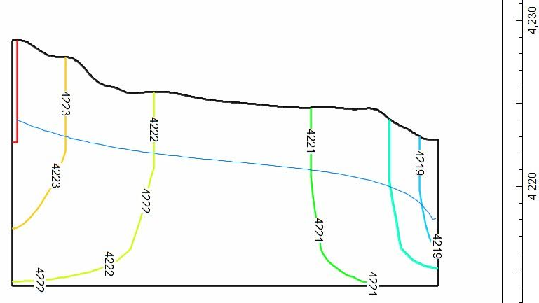
Problem Description & Desired Product
High water table
Desired Outcome !!

Slide 4
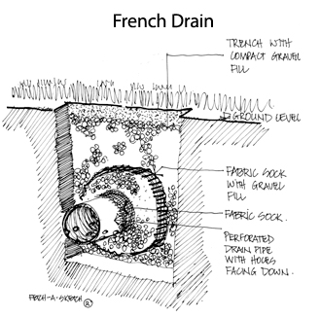
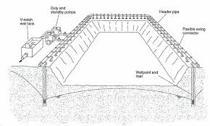
Potential Solutions
French Drains
Pumping

Slide 5
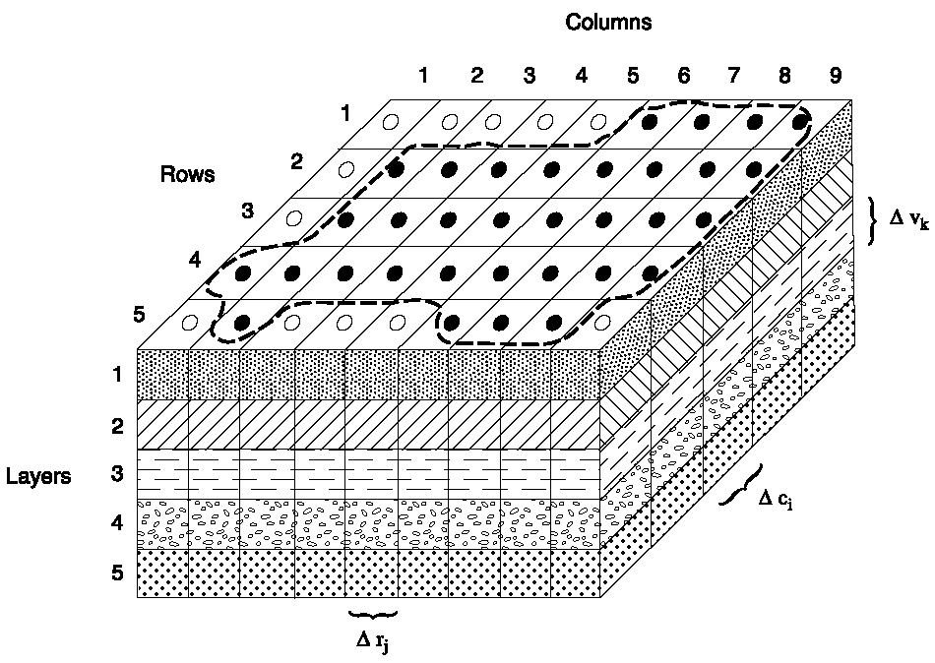
MODFLOW
Finite Difference numerical model developed by United States Geological Survey.
Model both steady state and transient flow in an aquifer.
MODFLOW operated by ModelMuse GUI.

Slide 6
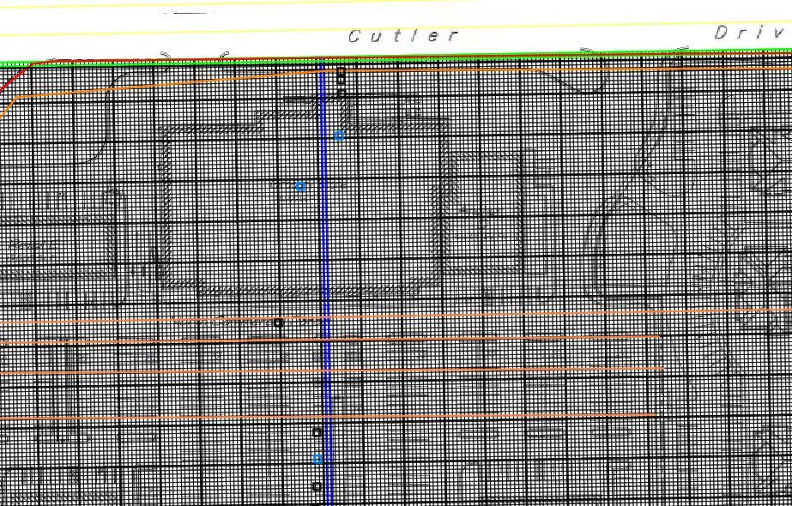
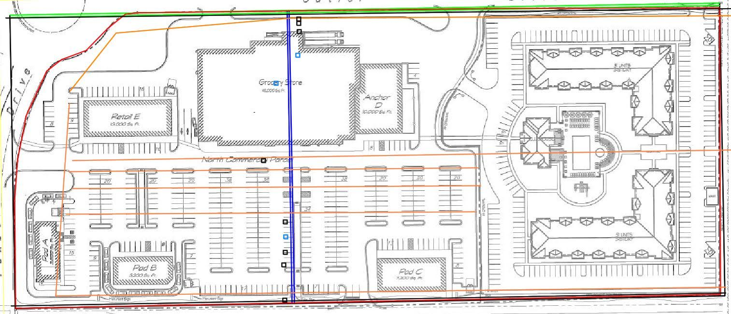
Building the Model
Inputs Required:
* Boundary Conditions
Two constant head boundaries
* Hydraulic Conductivity
Two ranges: 1 X 10^-9 cm/s (Clays) - 1 X 10^-3 cm/s (Sands)
High and Low Ranges were Modeled
* Specific Yield * Cell Size
2 - 20 % (USGS 1963) 4’ X 4’ Cells

Slide 7
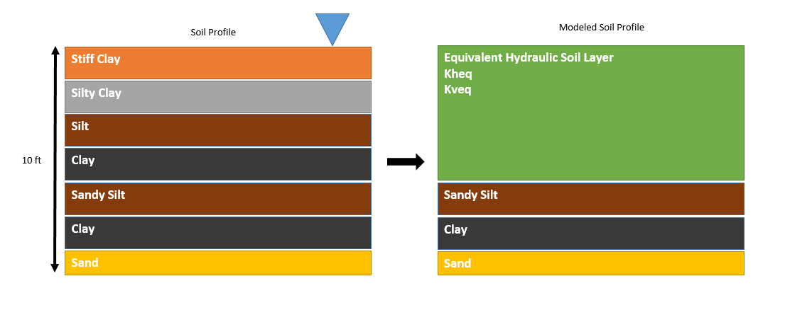
Building the Model

Slide 8
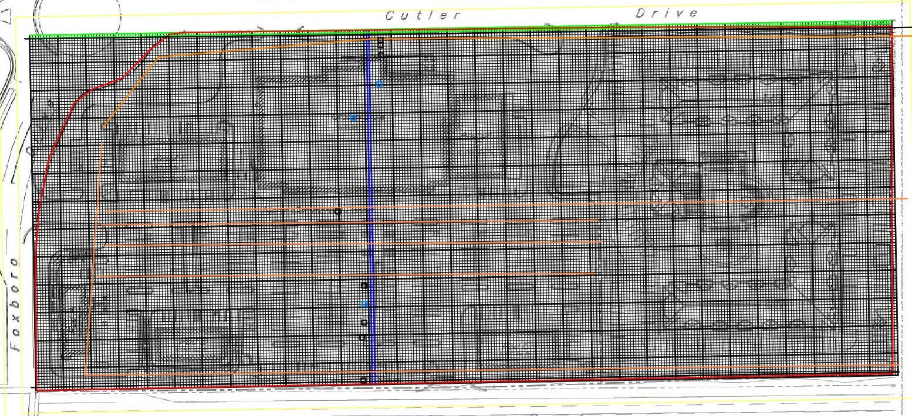
Running The Model
Transient (30 days, 60 days, 1 year, 3 years) and Steady State

Slide 9
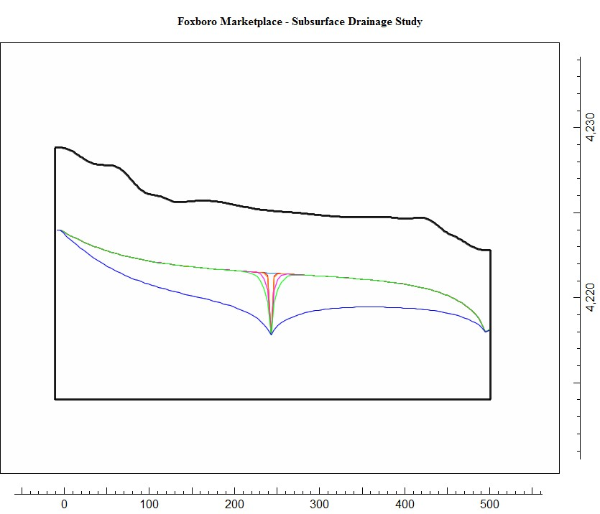
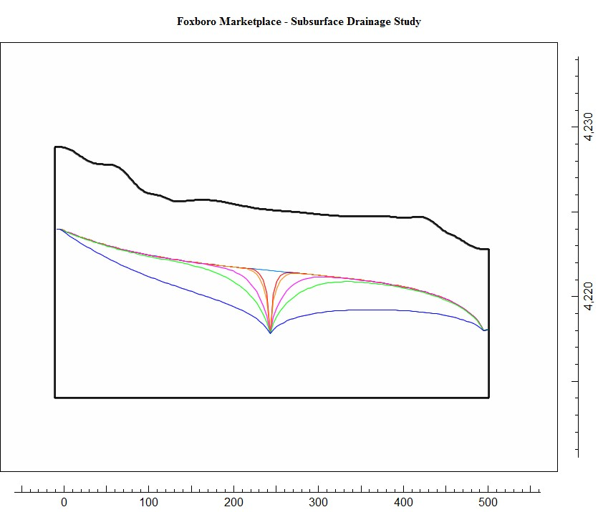
Results for a Single French Drain System

Slide 10
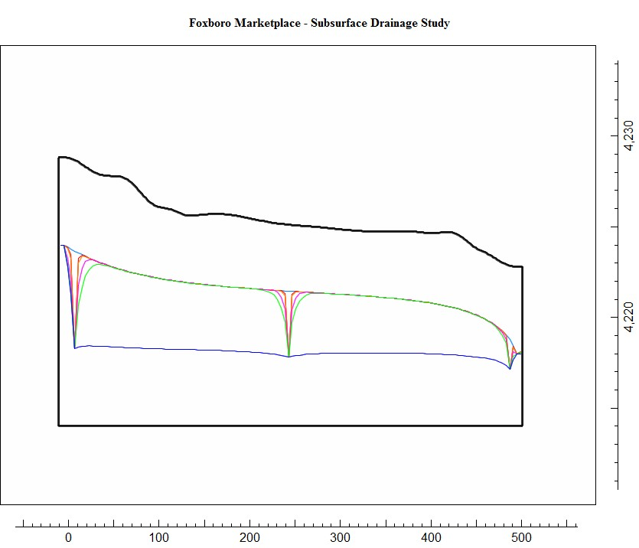
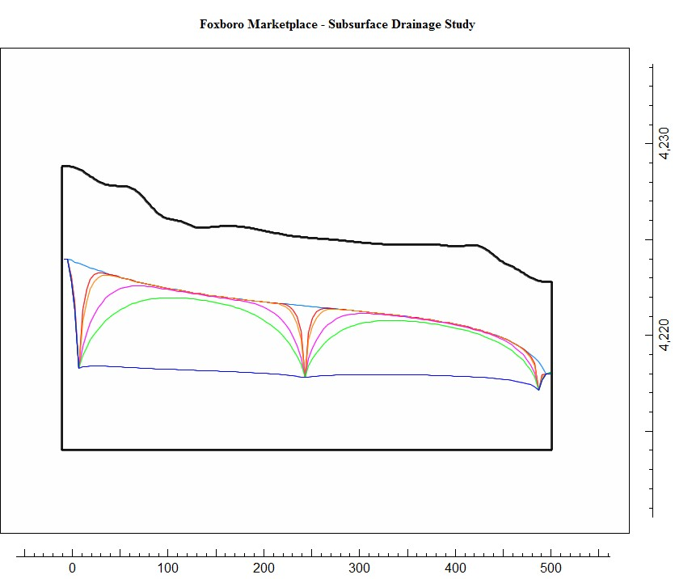
Results for a Triple French Drain System

Slide 11
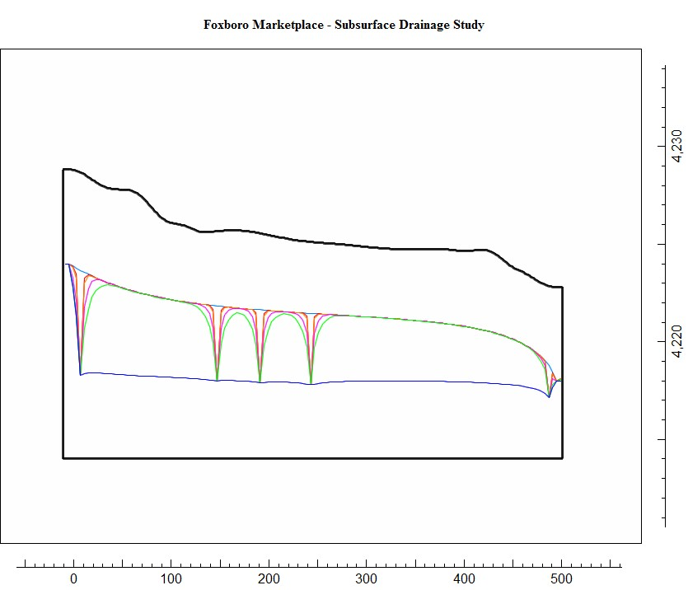
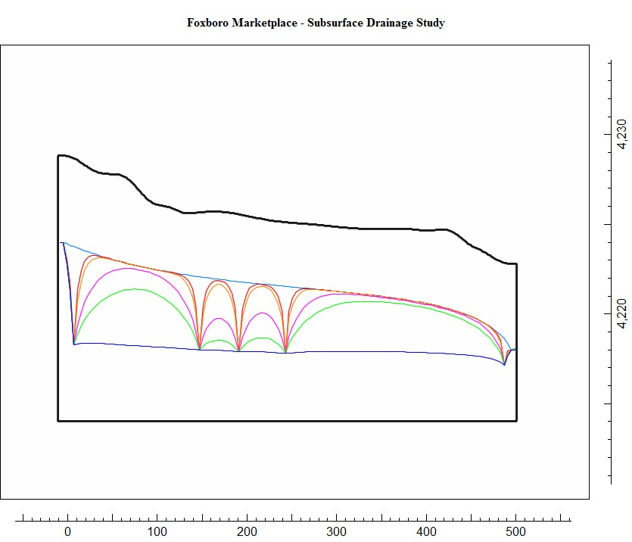
Results for Five Drains

Slide 12
Accuracy of the Model?
“...all models are wrong, but some are useful...”
-George Box
Time and money constraints limit the “accuracy” of the model.
Model improvements could have been made by:
Performing Hydraulic Conductivity Tests / Pump Tests
Refining Model with more layers
Calibrating Model using observed Heads
Converting from Regional Model to Local (Boundary Condition refinement)

Slide 13
Questions?

